Slide 1
Data Science Techniques and Real-
World Applications
Auto EDA
Zahra Sharafi
https://sites.google.com/view/zahrasharafi/home
Email: z.sharafi@fs.de
1
Notes:
1

Slide 2
Why automate EDA process?
Because:
EDA process takes a lot of time.
Manual EDA can sometimes lead to errors
2

Slide 3
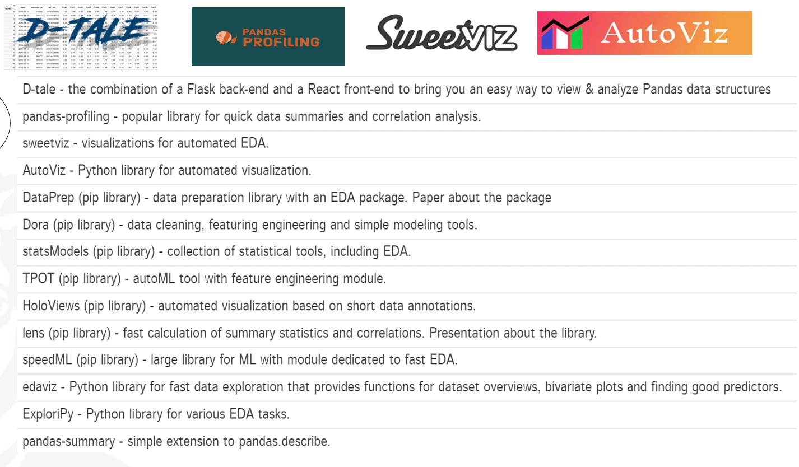
Auto EDA libraries
3

Slide 4
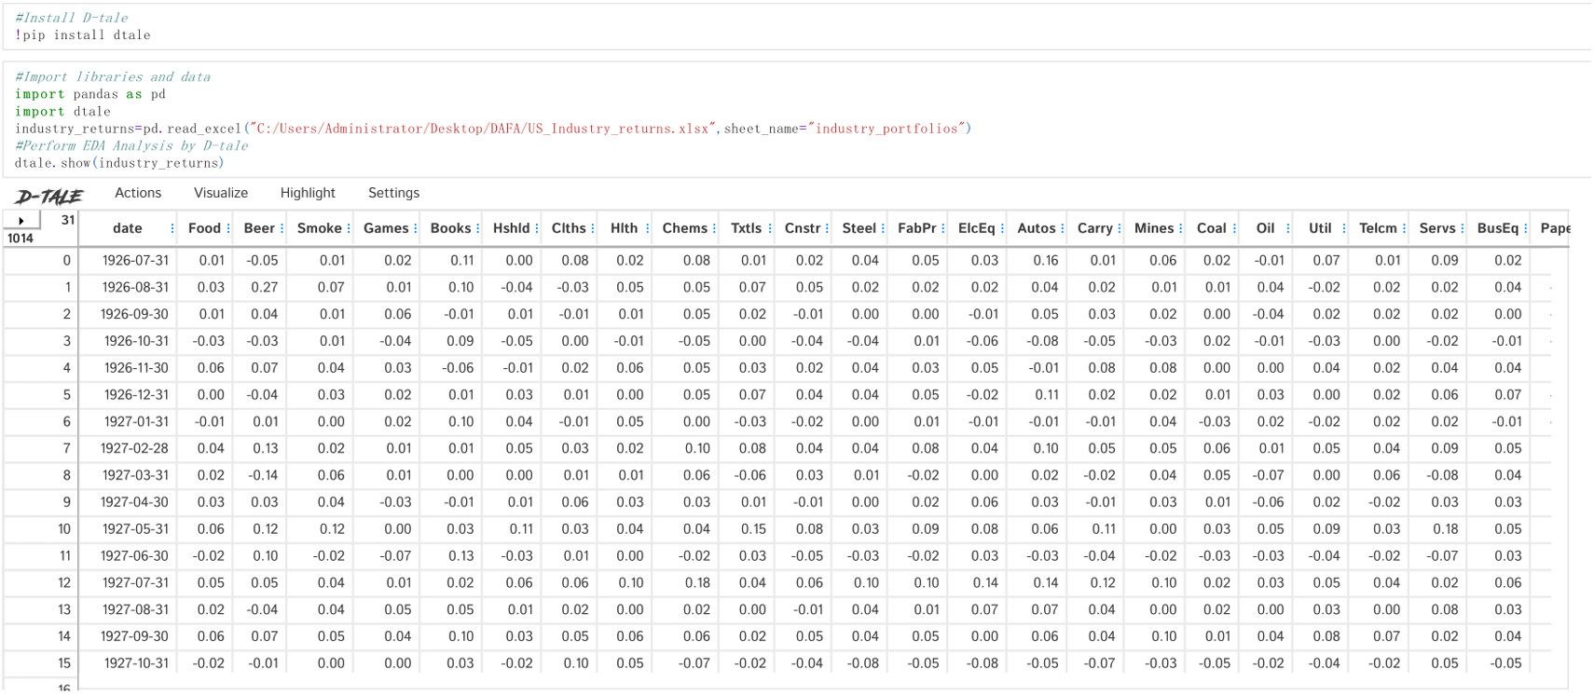
Auto EDA libraries– D-tale
4

Slide 5
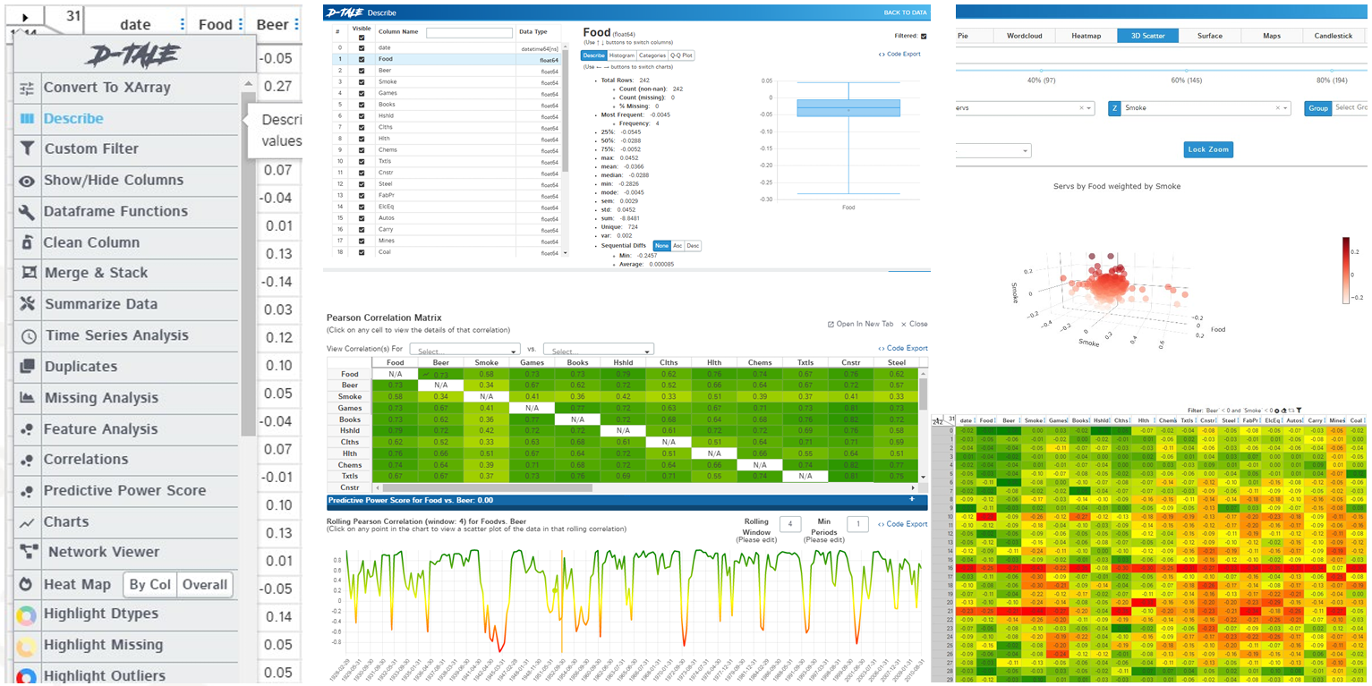
Auto EDA libraries– D-tale
5

Slide 6
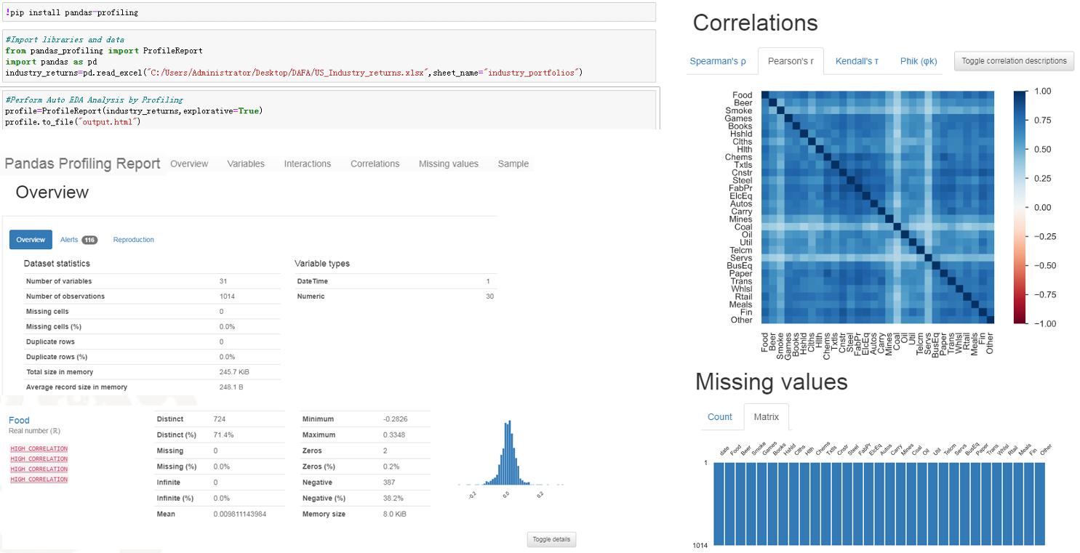
Auto EDA libraries – Pandas Profiling
6

Slide 7
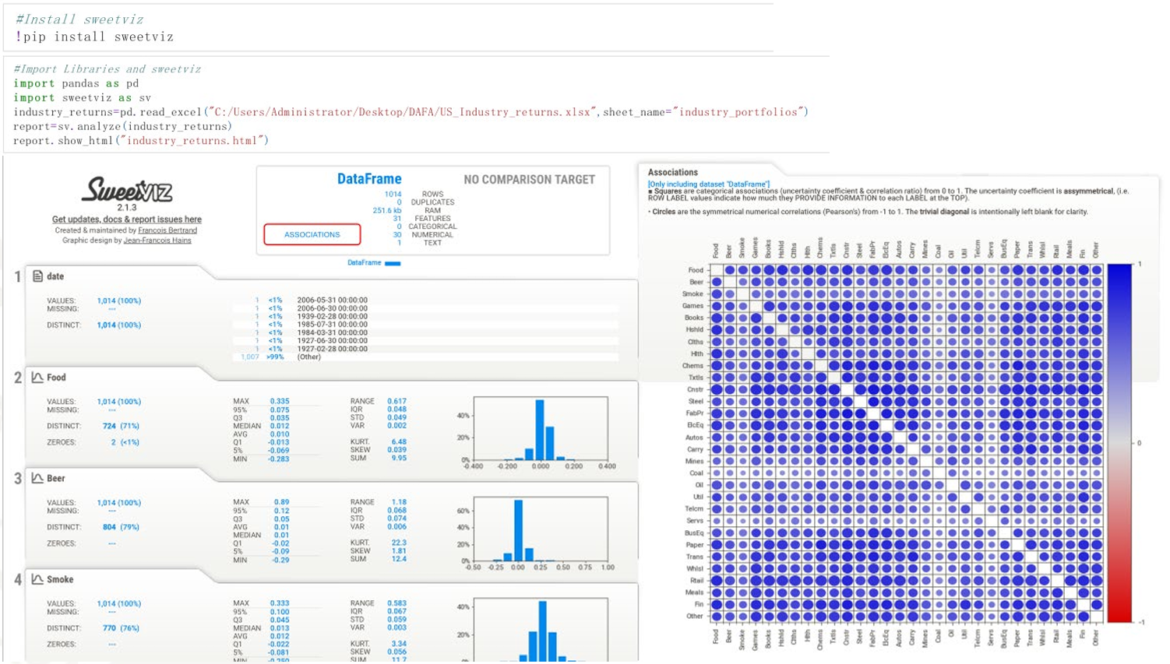
Auto EDA libraries - Sweetviz
7

Slide 8
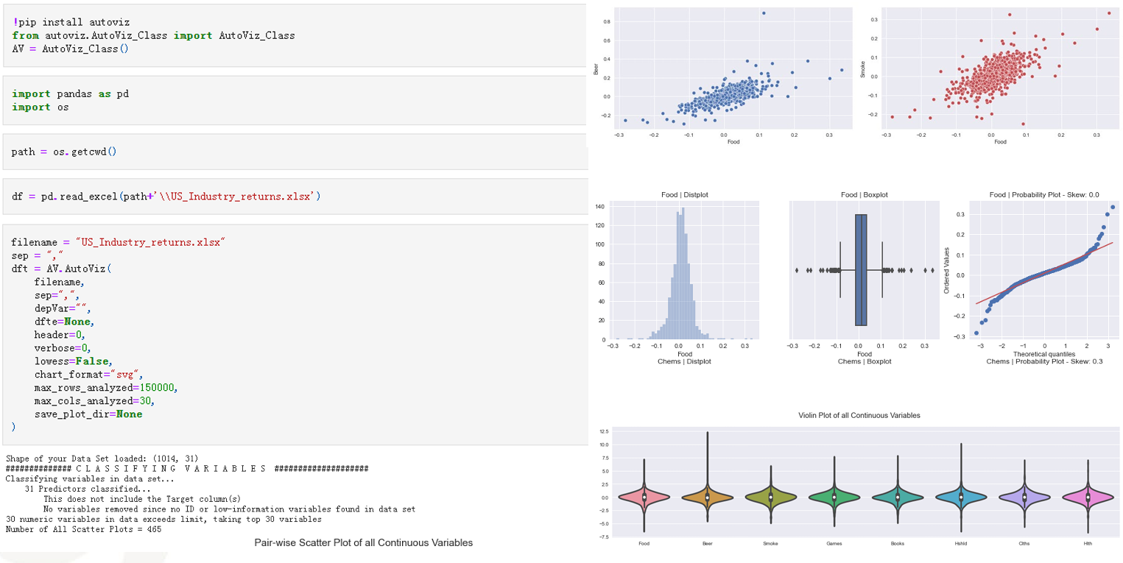
Auto EDA libraries – AutoViz
8

Slide 9
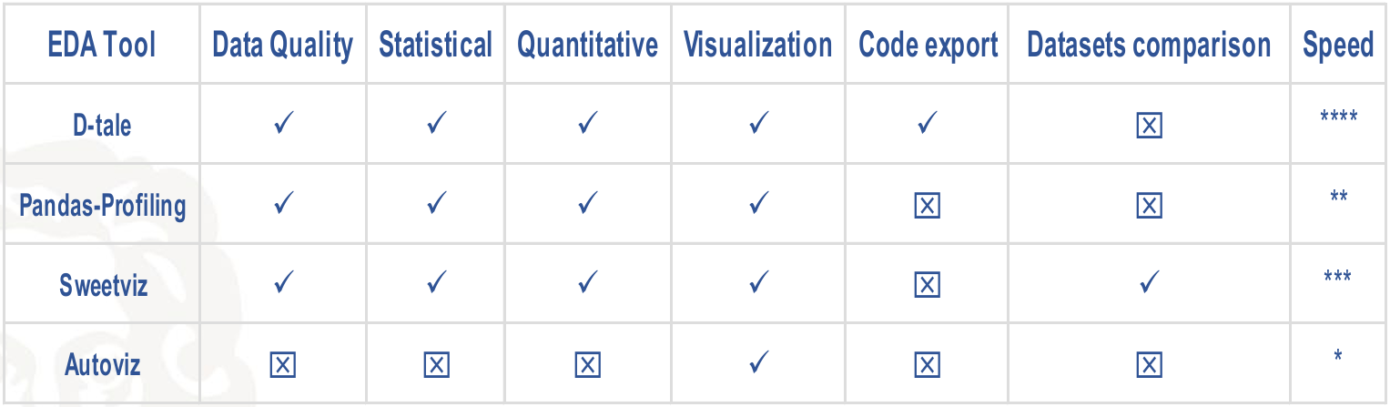
Auto EDA libraries – Comparison
9

Slide 10
References
Akshay Gupta, Top Python Libraries to Automate Exploratory Data Analysis in 2021. https://www.analyticsvidhya.com/blog/2021/04/top-python-libraries-to-automate exploratory-data-analysis-in-2021/
Auto EDA-resources. https://github.com/mstaniak/autoEDA-resources
Chirag Goyal, 20 Questions to Test Your Skills on Feature Engineering and EDA. https://www.analyticsvidhya.com/blog/2021/05/20-questions-to-test-your-skills-on-feature-engineering-and-eda/
Francis Adrian Viernes, Dramatically Improve Your Exploratory Data Analysis (EDA). https://towardsdatascience.com/dramatically-improve-your-exploratory-data-analysis-eda-a2fc8c851124
Ghosh, A., Nashaat, M., Miller, J., Quader, S., & Marston, C. (2018). A comprehensive review of tools for exploratory analysis of tabular industrial datasets. Visual Informatics, 2(4), 235-253.
Top Exploratory Data Analysis (EDA) Tool Comparison. https://www.bitrook.com/blog/exploratory-data-analysis-comparison
VanderPlas, J. (2016). Python Data Science Handbook, O'Reilly Media, Inc
10

